Slide 1
Statistical Analysis
Topic: Measures of Center and Spread
EQ: How do we work out the mean and median of a data set?

Slide 2
Quickwrite
On your left hand side of your page (task side) do a quickwrite for 2 minutes about data.
A few prompts to start your quickwrite:
Why do we collect data?
When is data useful?
When have you collected data?

Slide 3
Up - Talk - Down
Everyone stand up and in groups of 3-4 read out your quickwrite and then sit down and listen to the rest of the group share.
After everyone in your group is sitting down again, add at least one more point to your quickwrite.

Slide 4
Measures of Center and Spread EQ: How do we work out the mean and median of a data set?
What are data measures?
There are four data measures (mean, median, mode and range) they help us to summarise and make sense of the data.
What is the maximum number?
The largest number in the dataset
What is the minimum number?
The smallest number in the dataset
Example: 2, 4, 4, 5, 6, 8, 9, 10, 12, 14

Slide 5
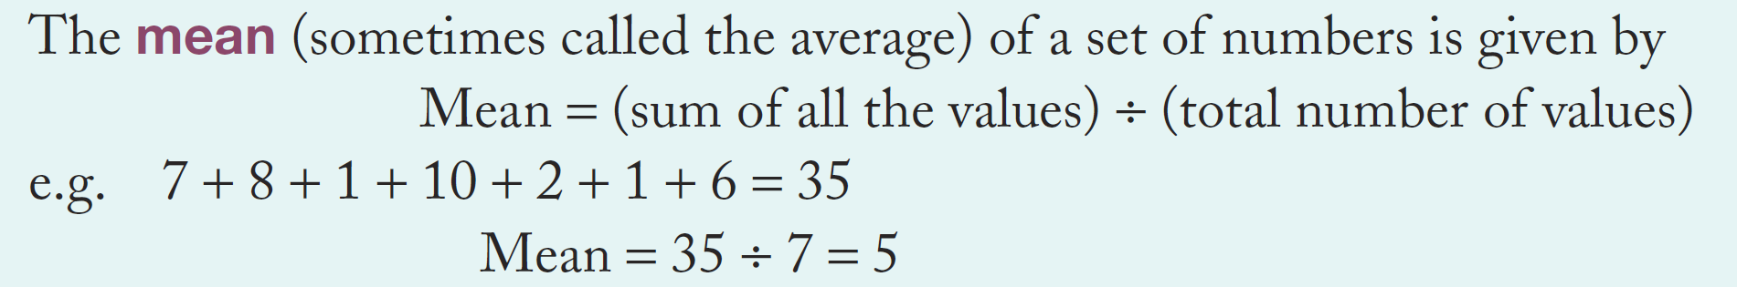
Measures of Center and Spread EQ: How do we work out the mean and median of a data set?
What is the mean?
We do together: Find the mean of the following data set
2, 3, 6, 8, 10, 13

Slide 6
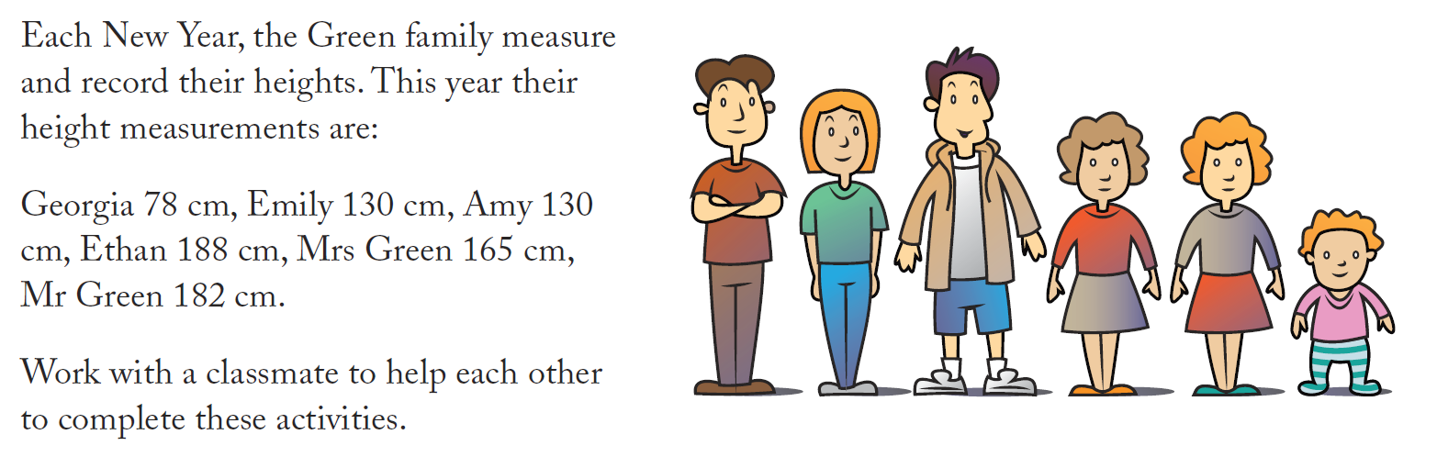
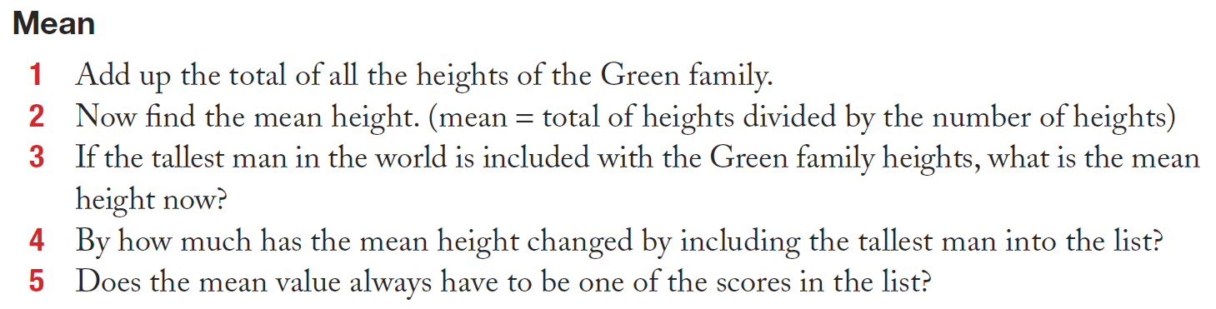
Tallest man in world: 251cm

Slide 7
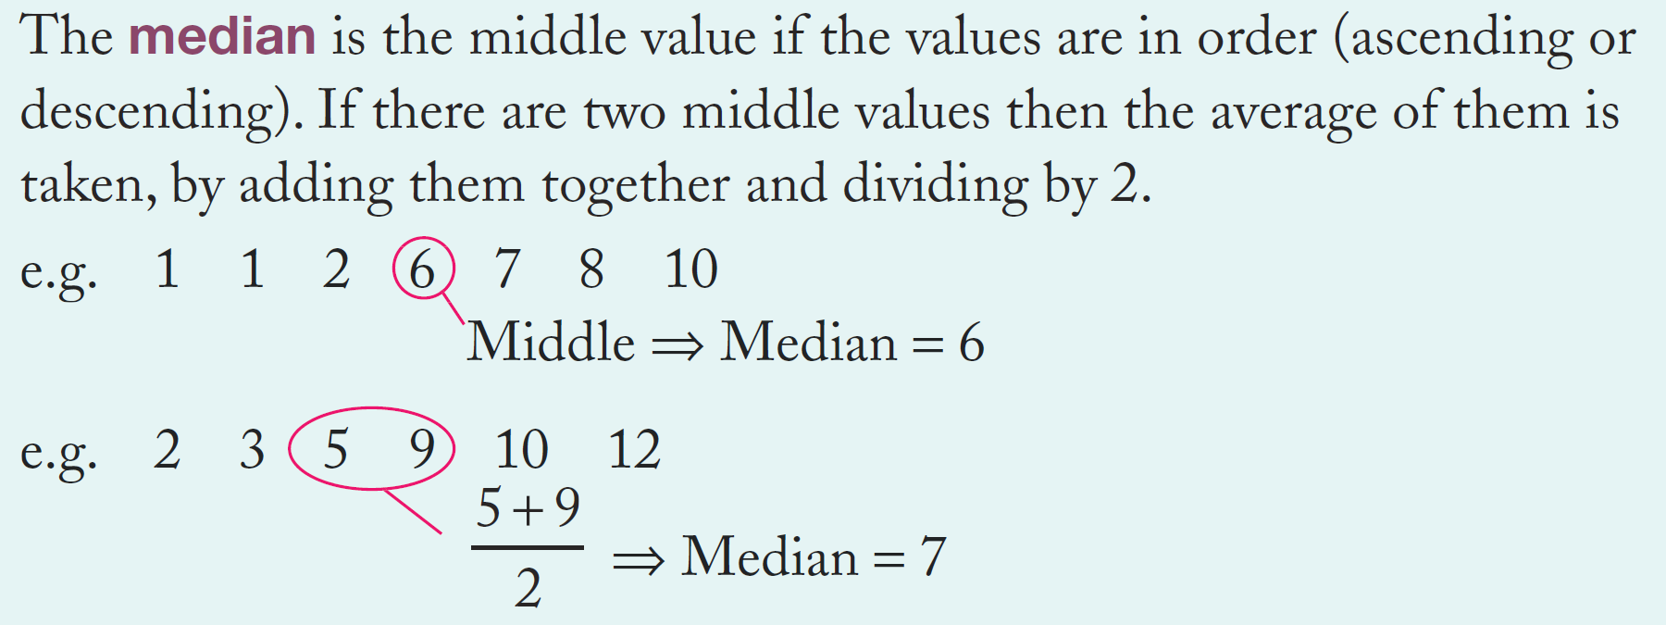
Measures of Center and Spread EQ: How do we work out the mean and median of a data set?
What is the median?
We do together: Find the median of the following data set
2, 3, 6, 8, 10, 13

Slide 8
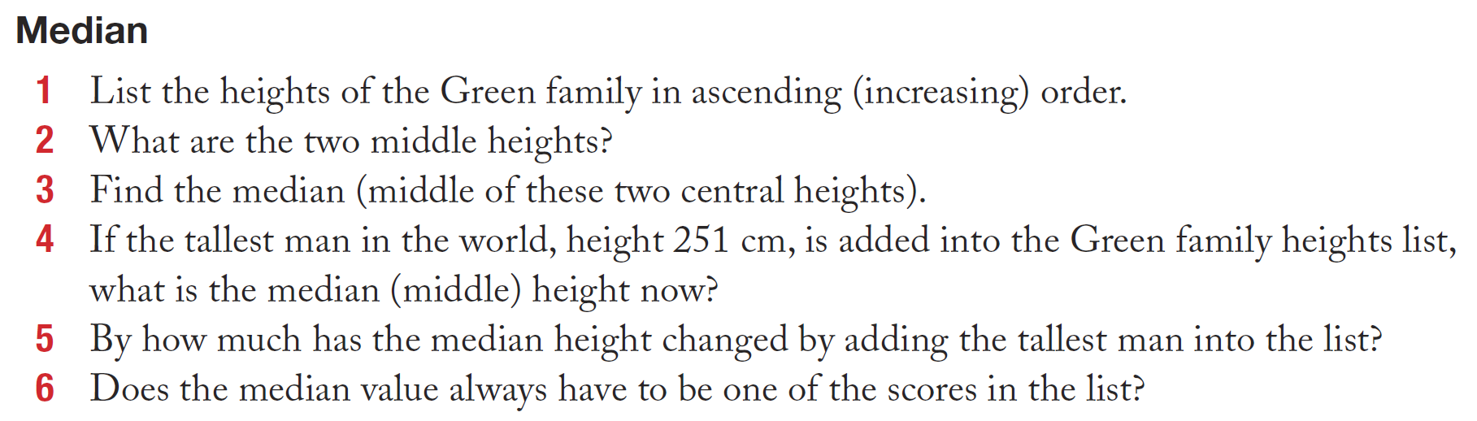

Slide 9
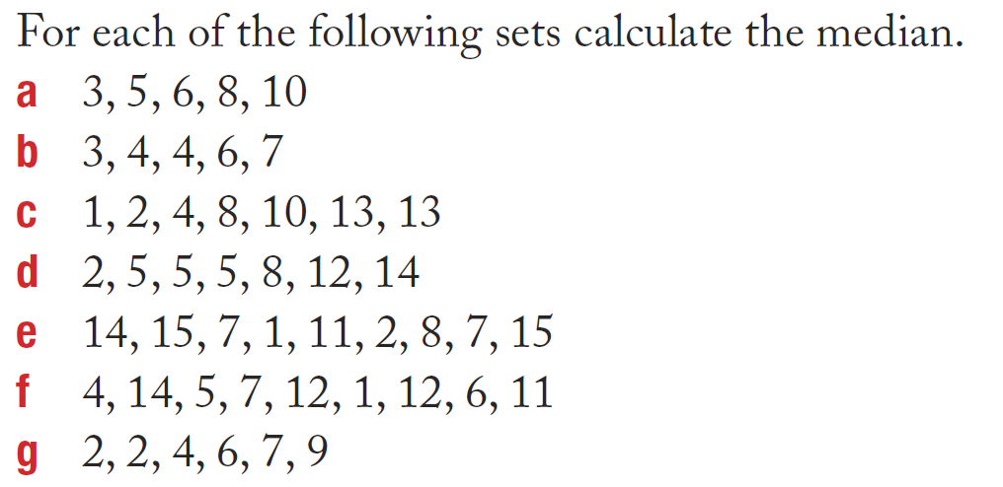
Independent practice
and mean.

